Slide 1
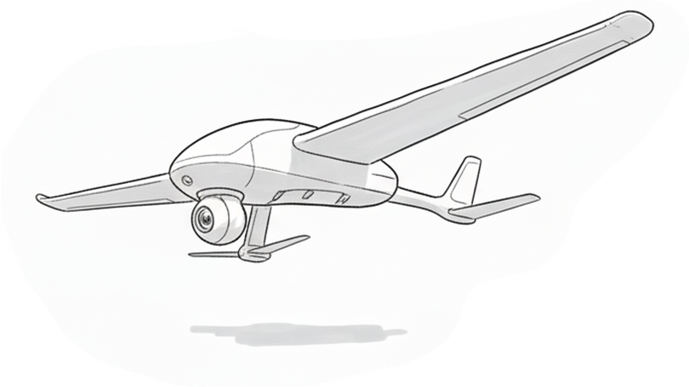
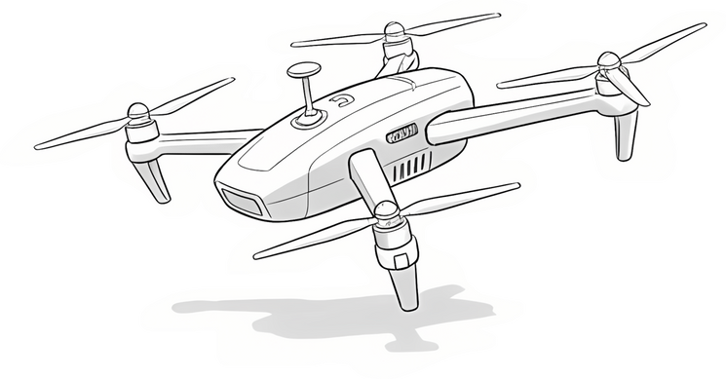
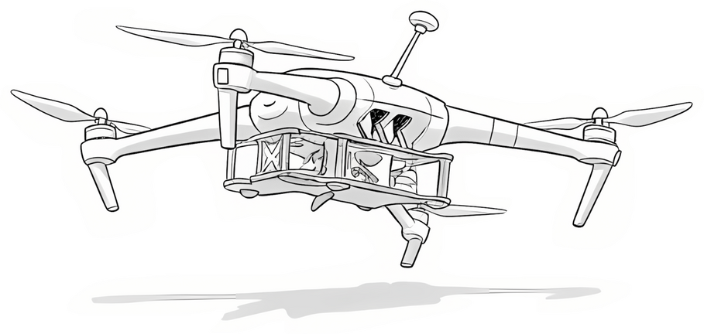
Subject: Introduction To Industry 4.0
Applications
of UAVs in
Industries
Presented by:
Satyartha Prakash
Sohan Kr. Das
Ajit Kumar
Sandeep Kumar
Umesh Kumar
Presented to: Prof. Dhruv Kumar

Slide 2
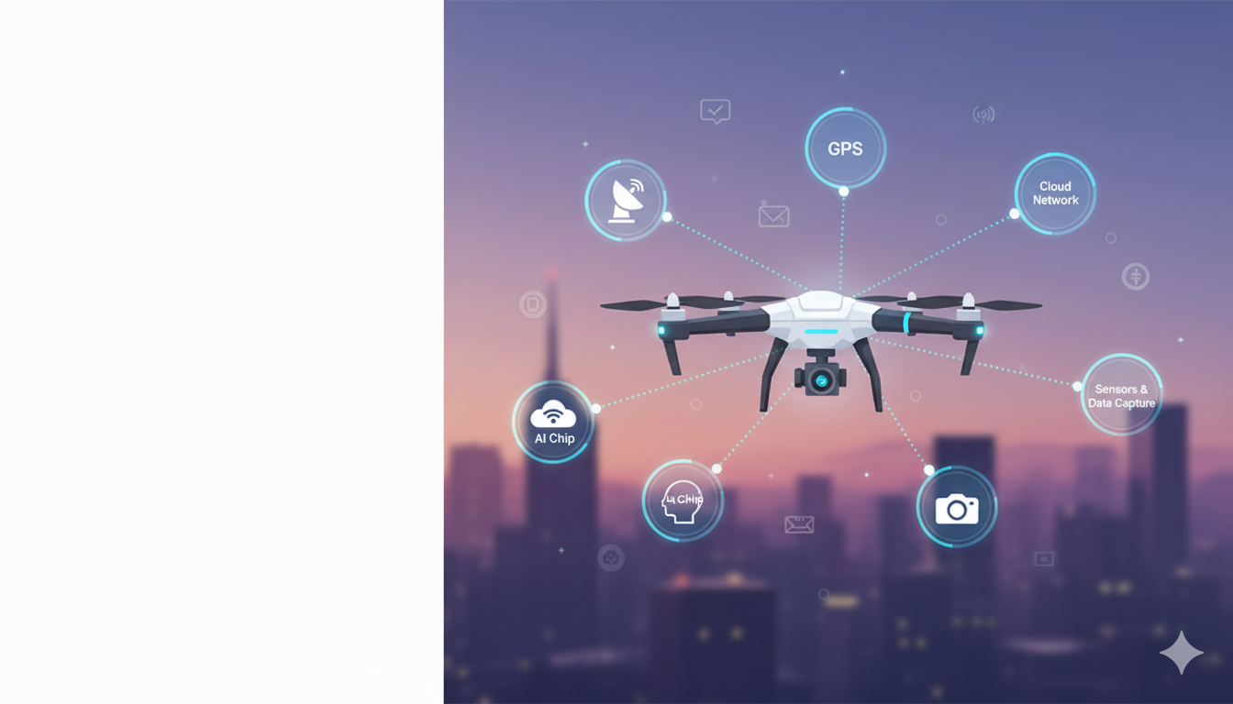
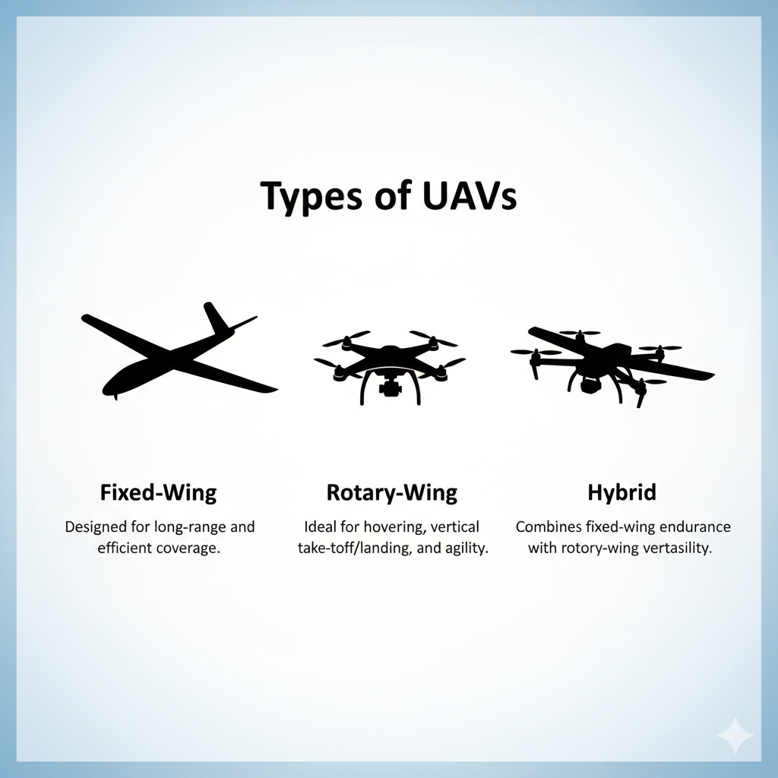
Introduction to UAVs
UAVs, or Unmanned Aerial Vehicles, are drones that fly without a human pilot onboard.
They can be remotely controlled or operate autonomously using sensors and GPS.
Types of UAVs:
Fixed-Wing (long range)
Rotary-Wing
(hovering, multi-rotor drones)
Hybrid (combination of both)
UAVs carry cameras, sensors, and AI chips to capture data and perform tasks.

Slide 3
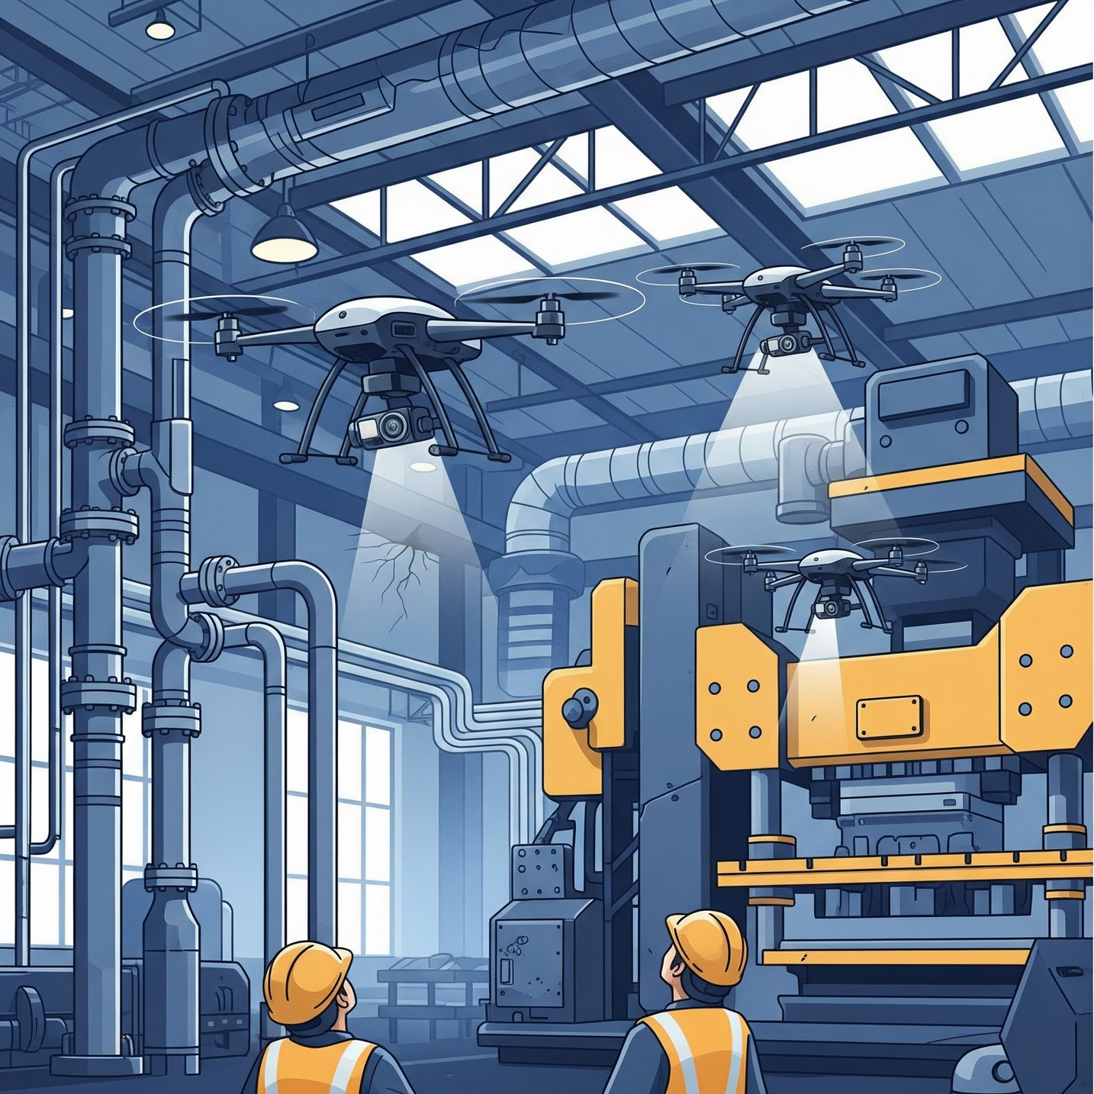
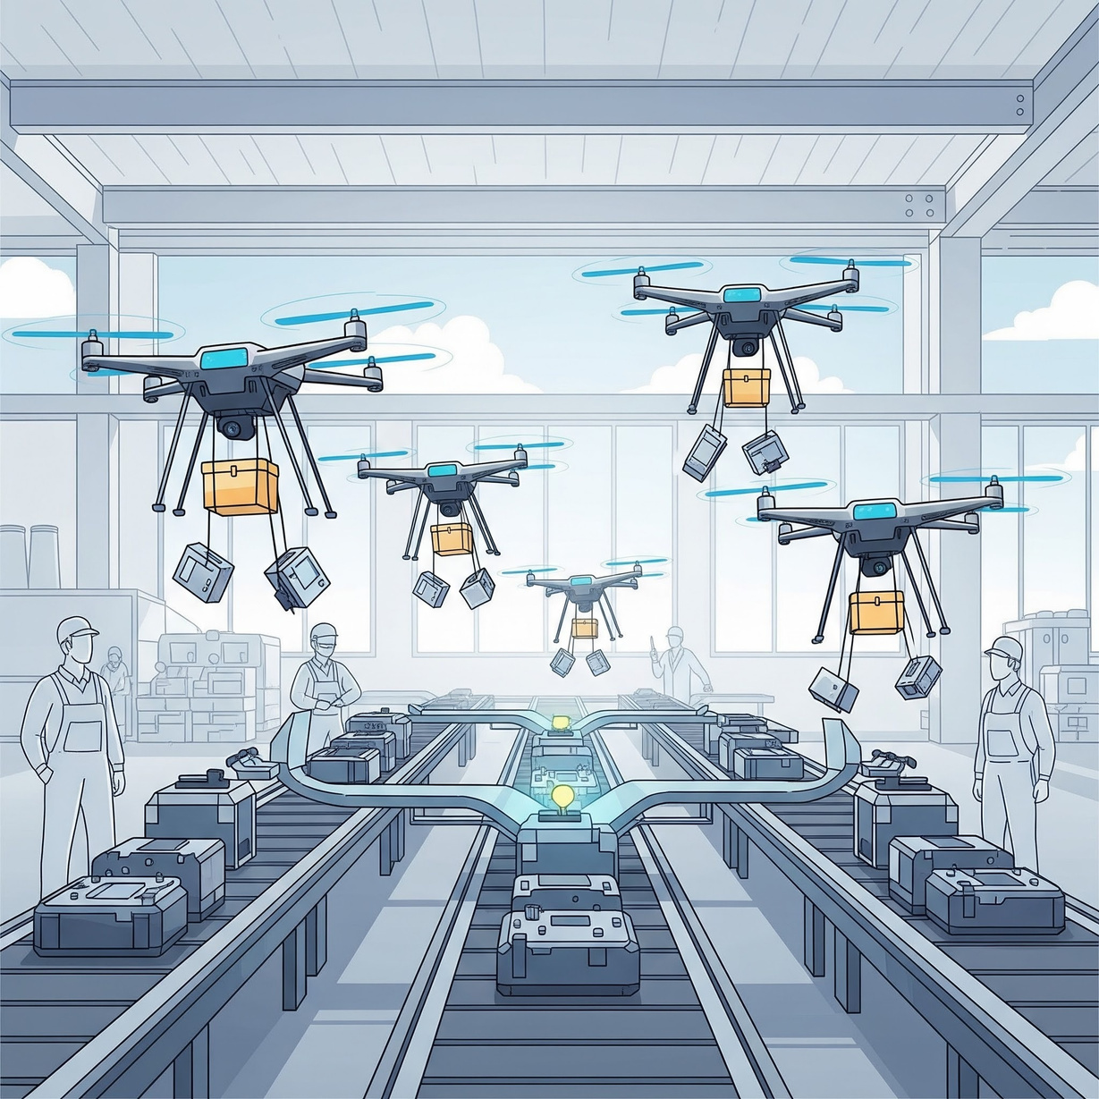
UAVs in Manufacturing Industry
Inspecting Hard-to-Reach Areas
Intra-Factory Logistics:
Drones inspect hard-to-reach machinery
to find faults early,
preventing costly shutdowns.
Drones transport small parts between assembly lines to keep the production process running smoothly.

Slide 4
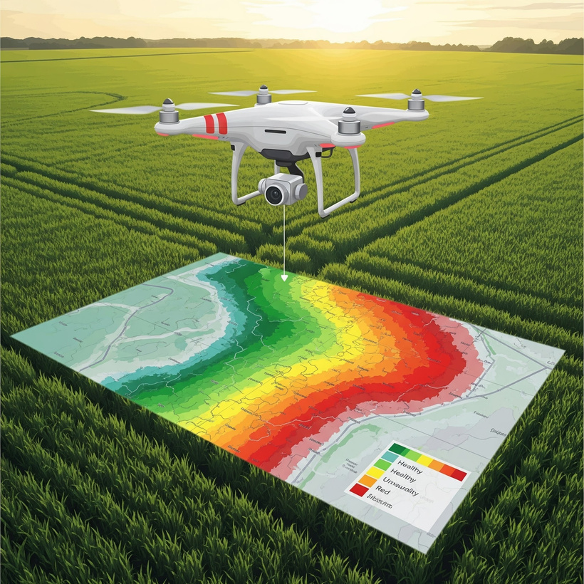
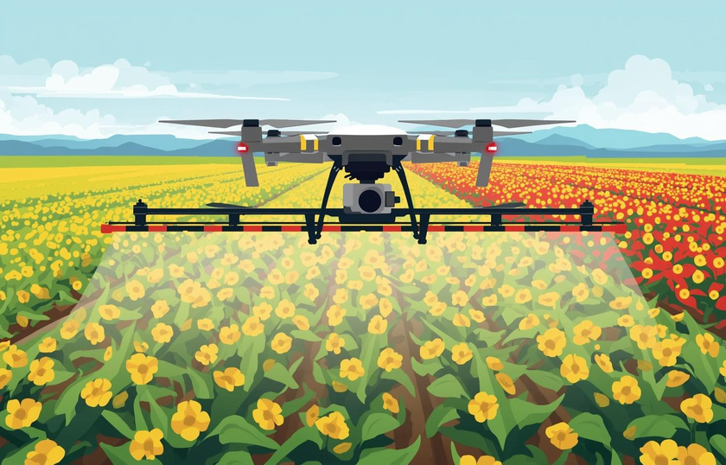
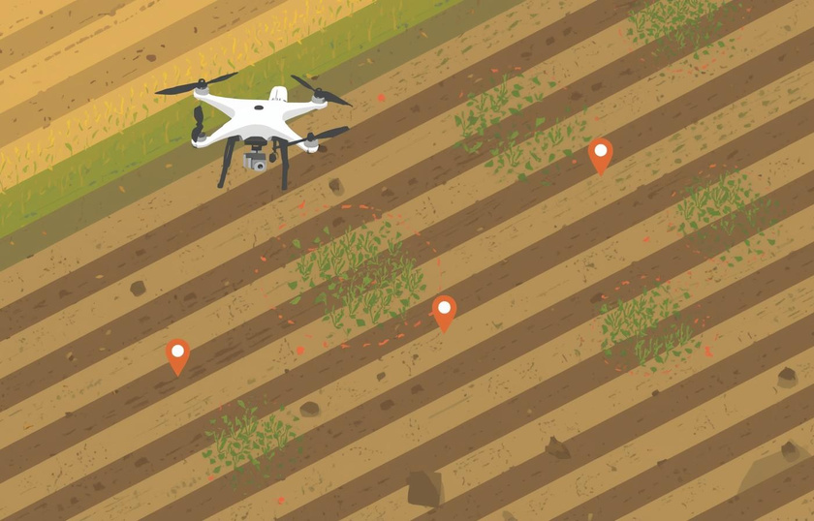
UAVs in Precision Agriculture
Checking Crop Health
Precision Spraying
Soil Analysis
Drones use special cameras (NDVI)
decide which plants are healthy
showing this information on a color-coded map.
Drones can be used to spray fertilizer or pesticides precisely where they are needed
saves money
better for the environment
Drones perform soil analysis for better crop management.

Slide 5
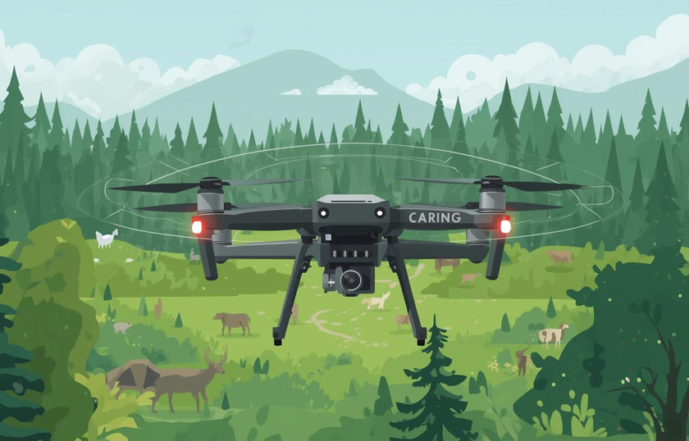
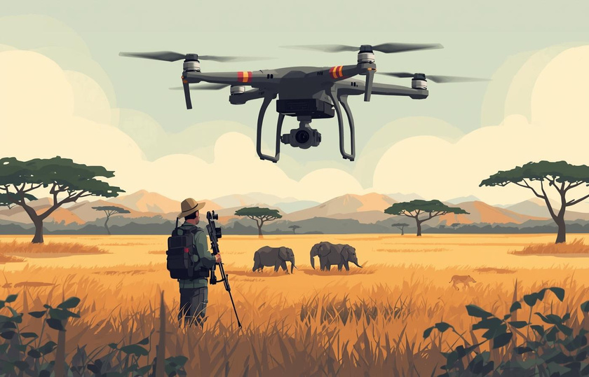
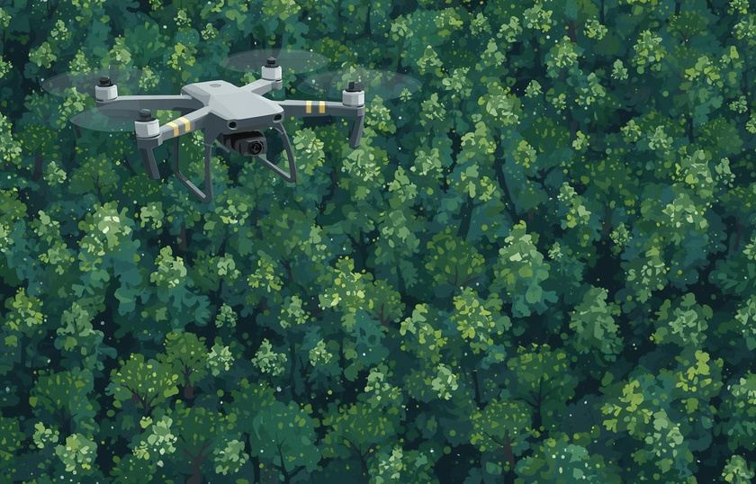
UAVs in Environmental Management
Habitat Monitoring
Anti-Poaching
Forest Health
Drones quickly scan large areas to count animals and track their movements without disturbing them.
Equipped with night-vision cameras, drones patrol large areas to spot illegal hunters and
protect endangered animals.
Assess forest conditions quickly, track deforestation,
and identify areas affected by pests or fires.

Slide 6
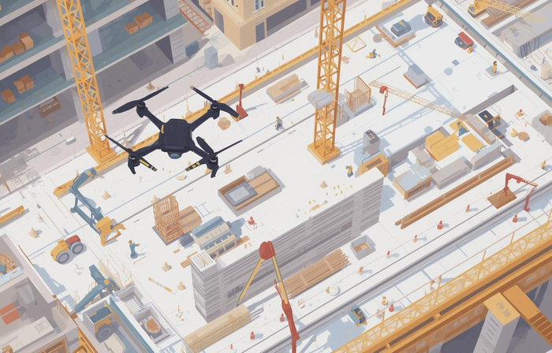
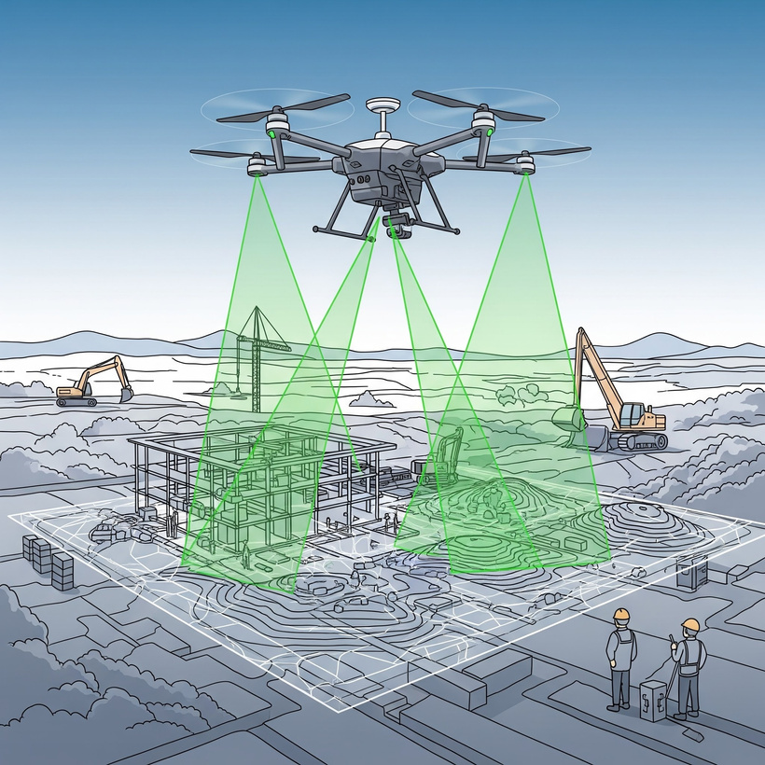
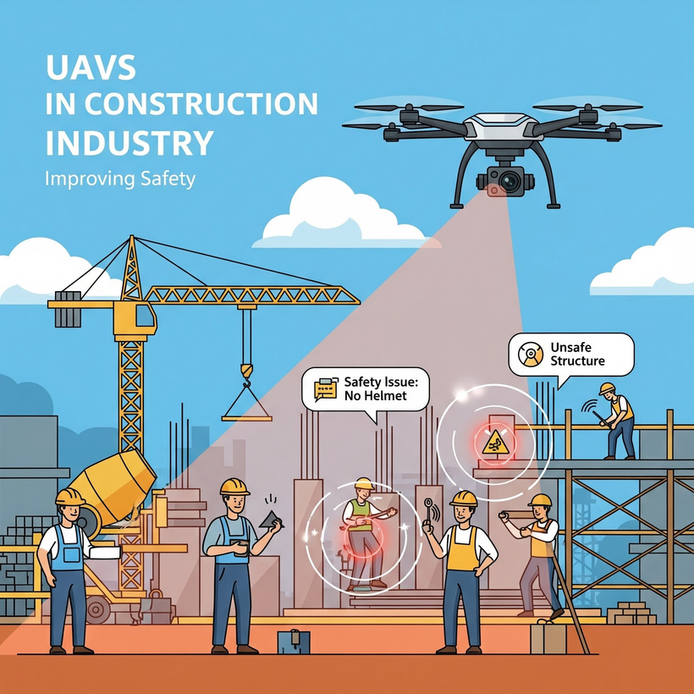
UAVs in Construction Industry
Monitoring Site Progress
Mapping and Surveying
Improving Safety
Drones provide a real-time view of the entire construction site,
allowing managers to track progress against plans.
Using LiDAR technology,
drones can create detailed 3D maps of the terrain
before construction even begins.
Drones can spot potential safety issues,
like workers not wearing helmets or unsafe structures,from a distance.

Slide 7
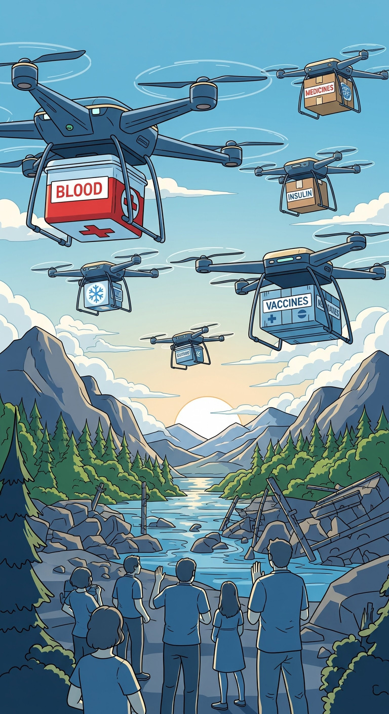
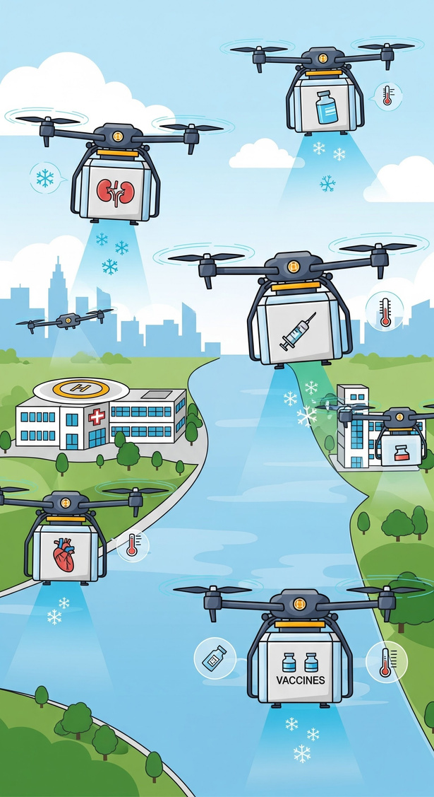
UAVs in Healthcare Industry
Delivering Emergency Medical Supplies
Organ Transportation
Drones help keep organs and vaccines at the right temperature during transportation
They ensure that these items stay safe and effective
Drones deliver blood, vaccines, insulin, medicines,
to remote or disaster zones where traditional transport fails.

Slide 8
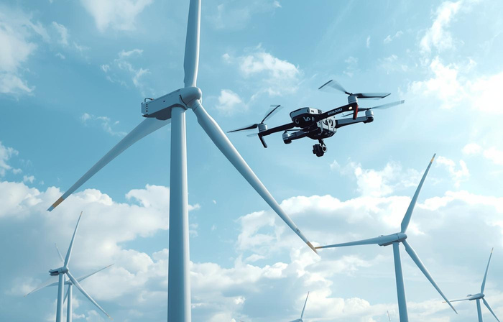
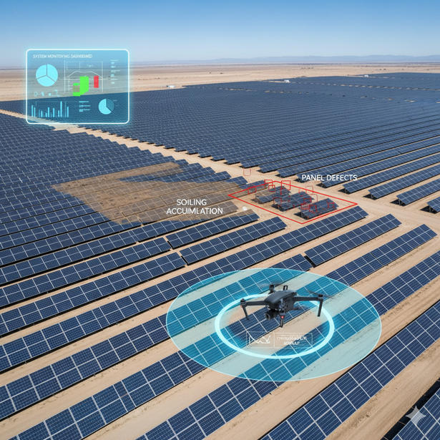
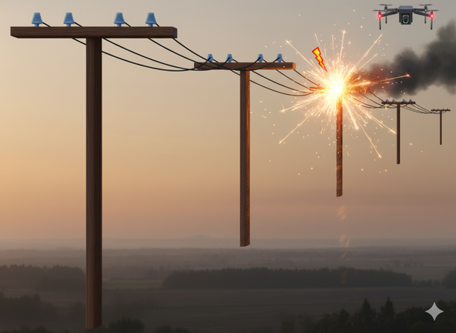
UAVs in Power & Energy Sector
Wind Turbine Assessment
Solar Farm Monitoring
Power Line Inspection
Checks the blades for damage, wear, and strength.
Using thermal cameras, drones can detect hidden damage on solar panels
Quickly inspects transmission lines and locate faults in power lines.

Slide 9
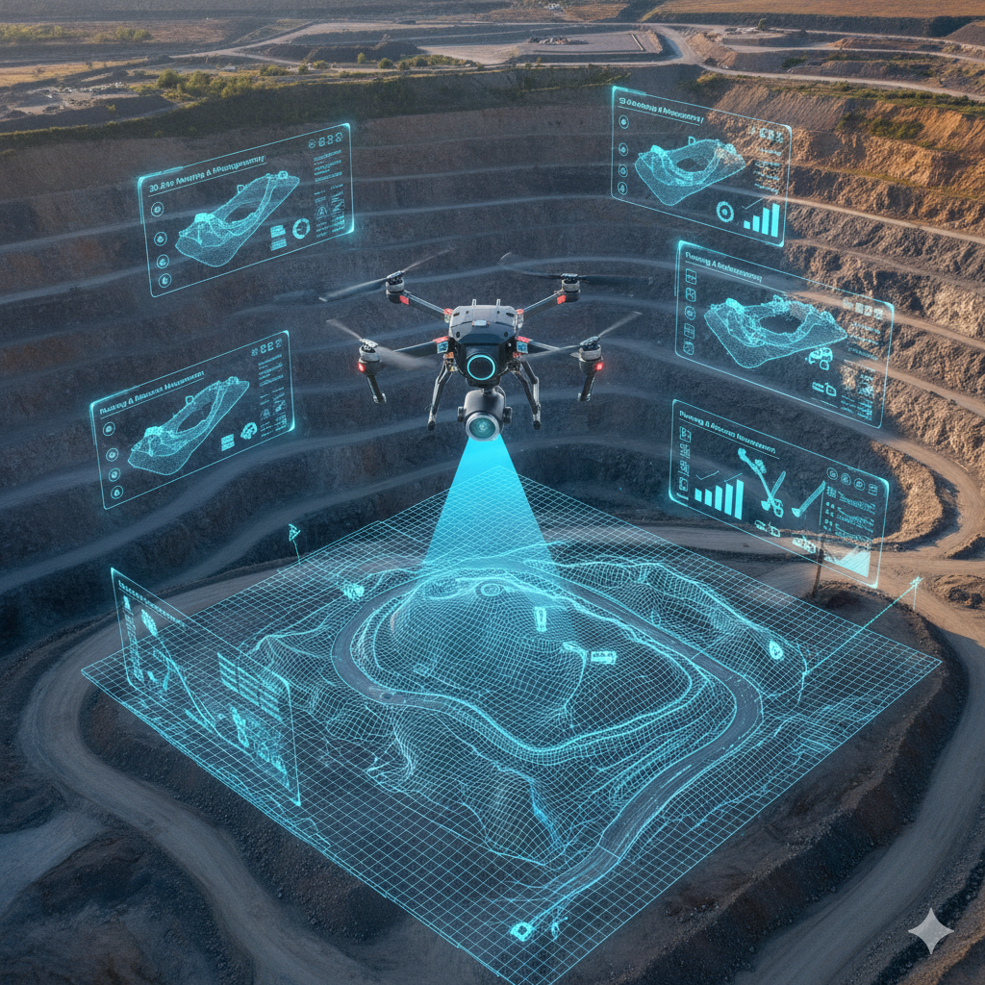
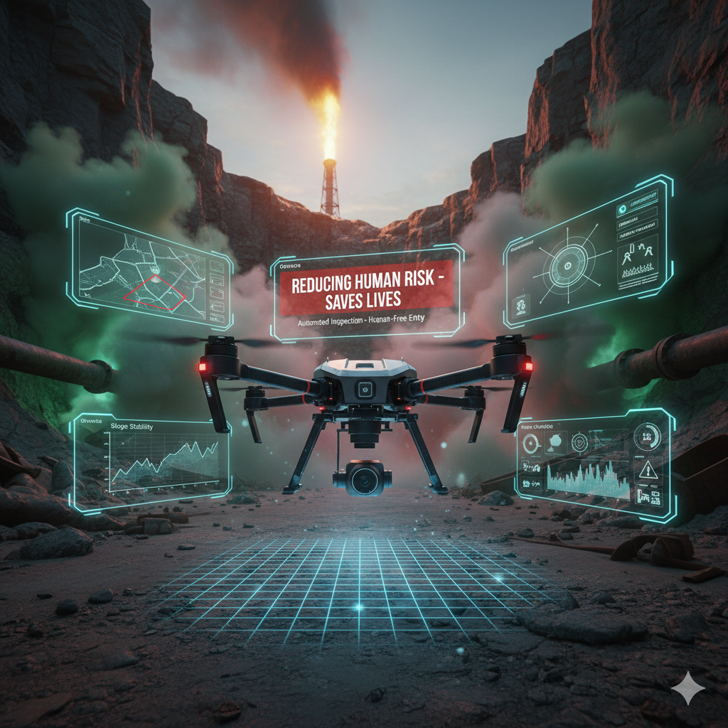
UAVs in Oil, Gas & Mining
3D Site Mapping
Reducing Human Risk
They are used to create accurate 3D maps of mining sites for better planning and resource management.
The single most important role here is reducing the need for human entry into hazardous zones, which saves lives.

Slide 10
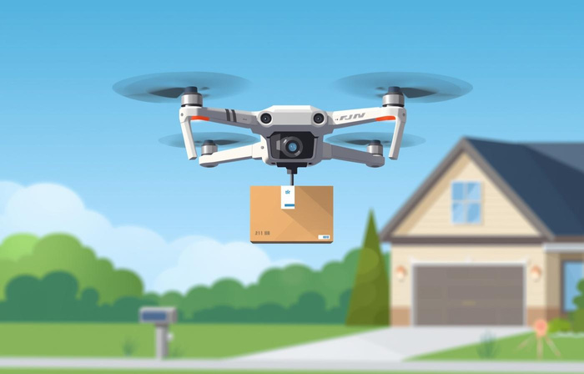
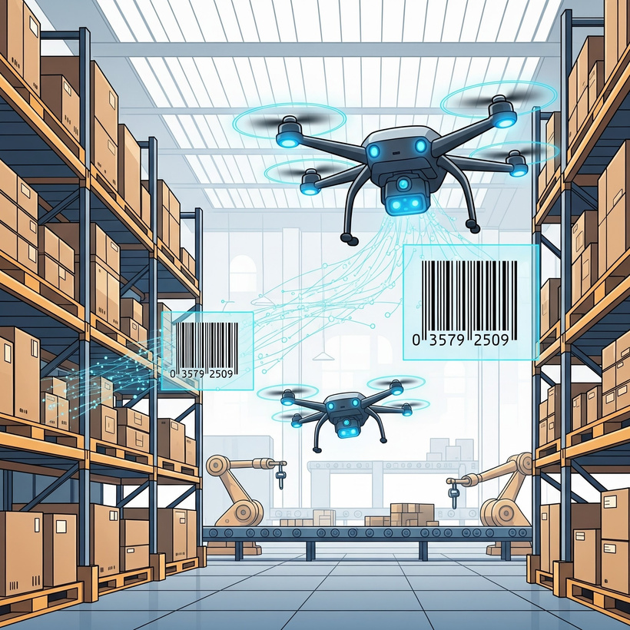
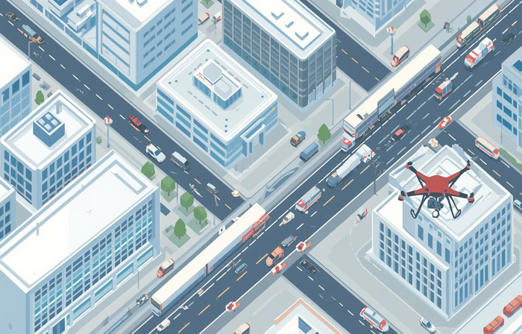
UAVs in Logistics & Delivery
Last-Mile Delivery
Warehouse Monitoring
Faster and Greener
Companies such as Amazon and Zomato are using drones to deliver packages straight to people's homes.
Drones fly through warehouses
Scanning barcodes to automate stock counting
Improving speed and accuracy
Drone delivery can reduce delivery times, especially in congested urban areas, and lower the carbon footprint of logistics.

Slide 11
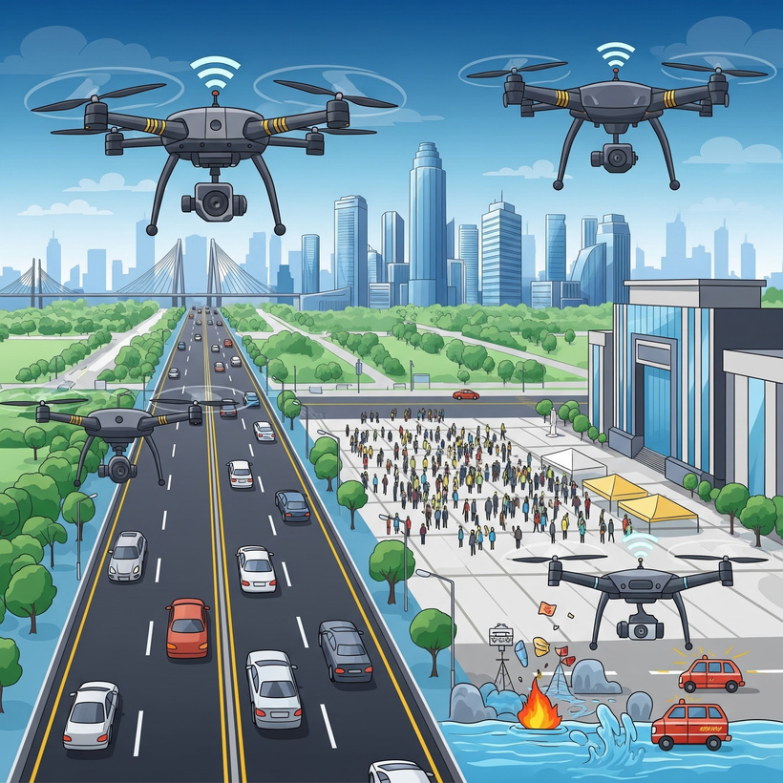
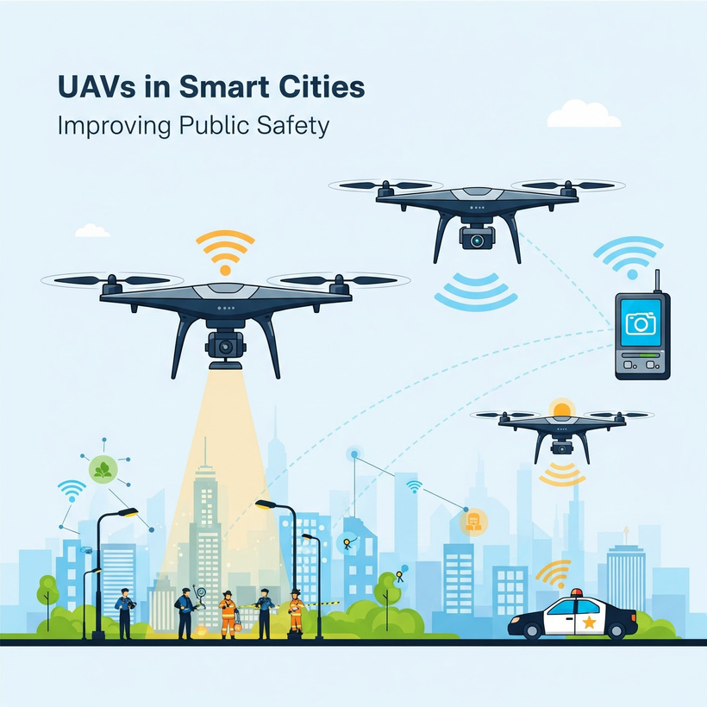
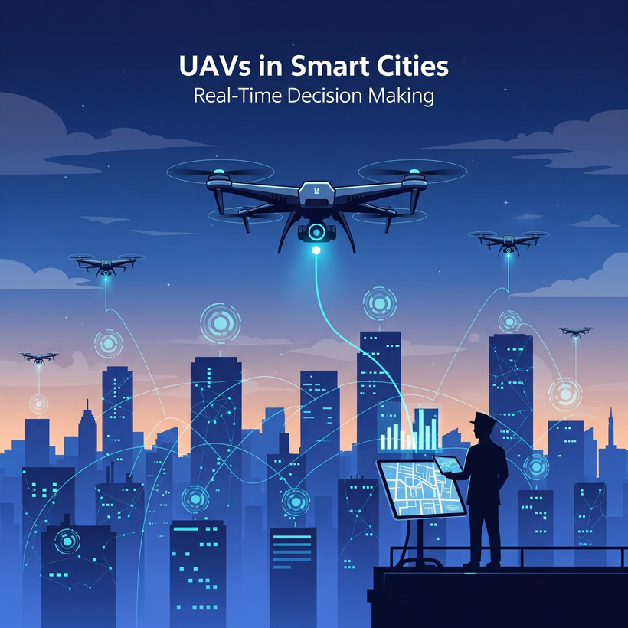
UAVs in Smart Cities
Real-Time Decision Making
Urban Management
Improving Public Safety
They are used to monitor traffic flow, manage large crowds at events, and respond quickly to disasters like fires or floods.
Drones assist law enforcement and emergency services, providing them with critical information from the air.
When connected to the city's IoT network, drones provide live data that helps officials make better, faster decisions.

Slide 12
Thankyou
धन्यवाद

